Slide 1
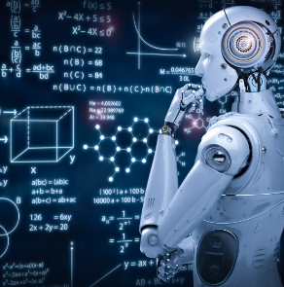
Machine Learning Fundamentals
Machine learning (ML) is a powerful field of artificial intelligence. It uses algorithms to learn from data and make predictions. ML allows computers to perform tasks without explicit programming.

Slide 2

What is Machine Learning?
Learning from Data
Types of Learning
ML algorithms learn patterns and relationships from data to make predictions or decisions.
Supervised, unsupervised, and reinforcement learning are the main categories of ML.
Applications
ML powers a wide range of applications, from image recognition to fraud detection.

Slide 3
Supervised Learning: Classification and Regression
Classification
Regression
Predicts categorical outcomes. For example, classifying emails as spam or not spam.
Predicts continuous values. For example, predicting house prices based on features.

Slide 4

Unsupervised Learning: Clustering and Dimensionality Reduction
1
Clustering
2
Dimensionality Reduction
Groups data points based on similarities, finding patterns without labels.
Reduces the number of features while preserving important information, simplifying data.

Slide 5



Neural Networks and Deep Learning
Neural Networks
Inspired by the human brain, they process data through interconnected nodes.
Deep Learning
Uses deep neural networks with many layers for complex tasks, like image recognition.

Slide 6

Feature Engineering and Selection
Feature Engineering
Creating new features from existing ones to improve model performance.
Feature Selection
Choosing the most relevant features to avoid overfitting and improve model efficiency.

Slide 7
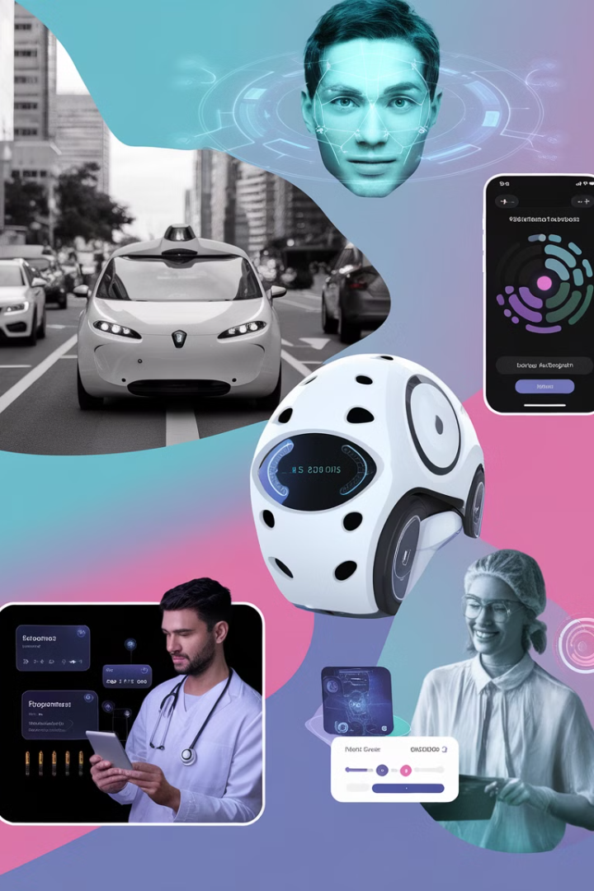




Real-World Applications of Machine Learning
Autonomous Vehicles
Healthcare
ML enables self-driving cars to perceive their surroundings and make decisions.
ML assists in diagnosis, drug discovery, and personalized treatment plans.
Finance
E-commerce
ML detects fraud, analyzes market trends, and provides personalized financial advice.
ML powers personalized recommendations and product search, enhancing user experiences.

Slide 8

Ethical Considerations in Machine Learning
1
2
3
Bias
Privacy
Transparency
ML models can perpetuate existing societal biases if trained on biased data.
Protecting user privacy is critical as ML models often process sensitive personal information.
Understanding how ML models make decisions is crucial for accountability and trust.

Slide 9

Q&A and discussion
Let's discuss the potential and implications of AI.
1.What is the difference between supervised and
unsupervised learning?
2.What is a training dataset?
3.What are some common algorithms used in Machine
Learning?

